Slide 1

Clustering Italian restaurants
In NYC
A data-driven approach for opening a new restaurant
Andrea Sarni, Aug 2021

Slide 2
Agenda
1
Context
2
Approach
3
Analytical model
4
Discussion

Slide 3
Clustering Italian restaurants in NYC| Context
New York City & Italian cuisine
New York is the most populous city in the United States. With an estimated 2020 population of 8,253,213 distributed over about 302.6 square miles (784 km2), New York City is also the most densely populated major city in the United States
5 Boroughs: Brooklyn, Queens, Manhattan, the Bronx, and Staten Island
Italian cuisine is one of the top three cuisines in the United States, according to the National Restaurant Association
(around 1k restaurants out of 20k total restaurants in NYC (Indian, French or Thai cuisines count only 300 restaurants each!)
Business Question:
Giving the great extension of the city, is there a data-driven approach to determine which among all neighborhoods (division of each borough) are the best solution to locate a new activity, in order to have the best solution in terms of attractivity and profitability?

Slide 4
Clustering Italian restaurants in NYC| Approach
From a real problem to a real solution, through data
Problem setting
Understanding the neighborhoods of NYC in terms of population and category of commercial activities, to define the best neighorhood to place an italian restaurant. The answer should find a neighborhood balancing specific principles*
*Principles
Max number of Italian Restaurants: this ensures that in the neighborhood the italian cuisine is really appreciated
Max average salary: this ensures that a lot of people would be able to spend their money in the restaurant
Max size of population: this ensures that a lot of people could enter in the restaurant and talk about it around the city
Min average rate of Competitors: this ensures that the level of competition will be not so hard
Bottom-up: from data to real solution
Data Assessment & Availability
For this problem we would need 2 groups of information:
Geographic data
Demographic data
Restaurants data
Real Problem solution
Results Discussion
Story Telling
Data Analysis Design
Descriptive Analysis
Clustering problem → K-Means algorithm
Top-down: from real problem to data

Slide 5
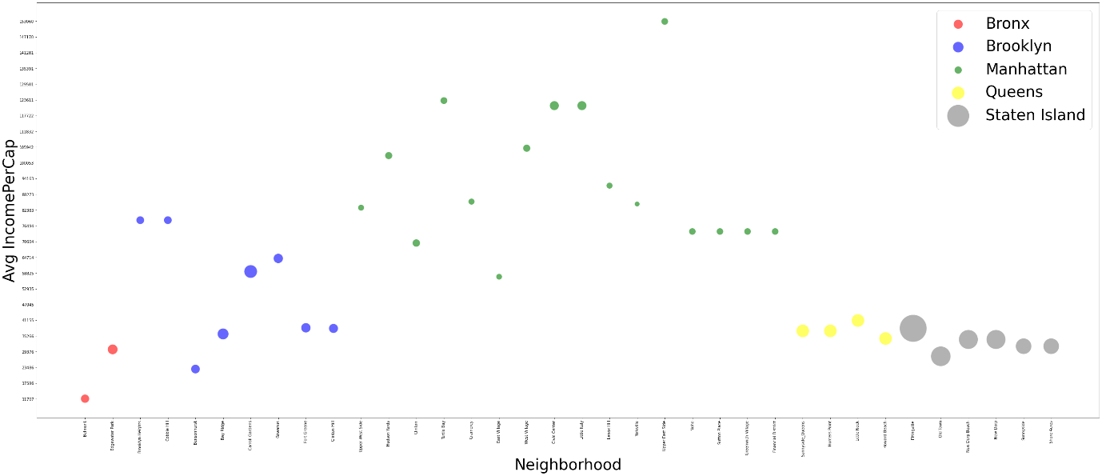
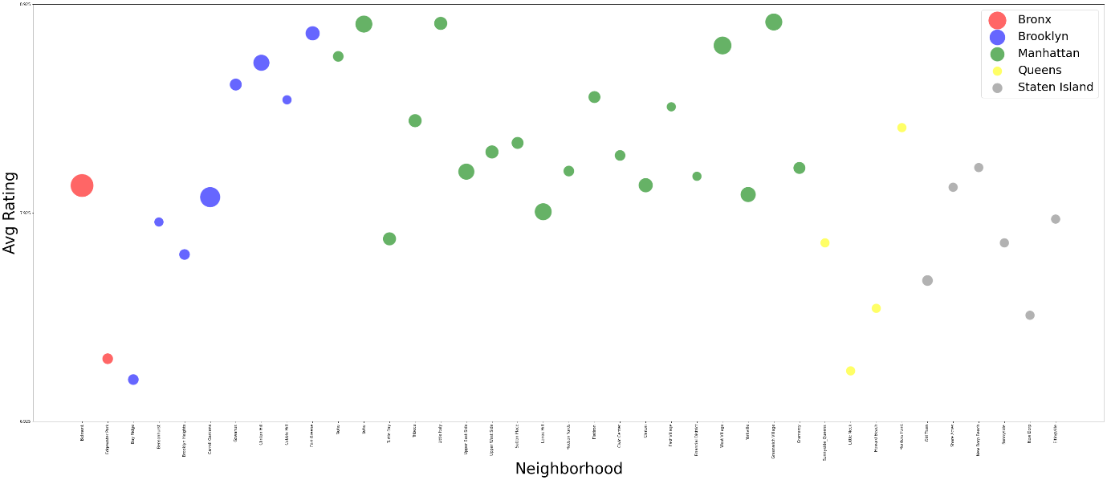
Clustering Italian restaurants in NYC| Analytical Model
Data Analysis
Demographic data (y=IncomePerCap; size=Density)
Comments
Bronx: Low Income – Low Density
Brooklyn: Mid Income – Mid Density
Manhattan: High Income – Low Density
Queens: Low Income – Mid Density
Staten Island: Low Income - High Density
Neighborhoods in Manhattan and Brooklyn could be good candidates based only on this variables.
Queens and Bronx (especially Belmont) seem to be the worst candidate.
Staten Island shows good value in terms of density but low average income per cap.
Restaurants data (y=Rating; size=N. of Restaurants)
Comments
Bronx: Low Rating – Mid N. of Restaurants
Brooklyn: Mid Rating – Mid N. of Restaurants
Manhattan: High Rating – Mid N. of Restaurants
Queens: Low Rating – Low N. Restaurants
Staten Island: Low Rating – Low N. Restaurants
Neighborhoods in Manhattan and Brooklyn show high rated restaurants but high likelihood for Italian cuisine.
Queens and Staten Island show low rated restaurants but low likelihood for Italian cuisine.

Slide 6
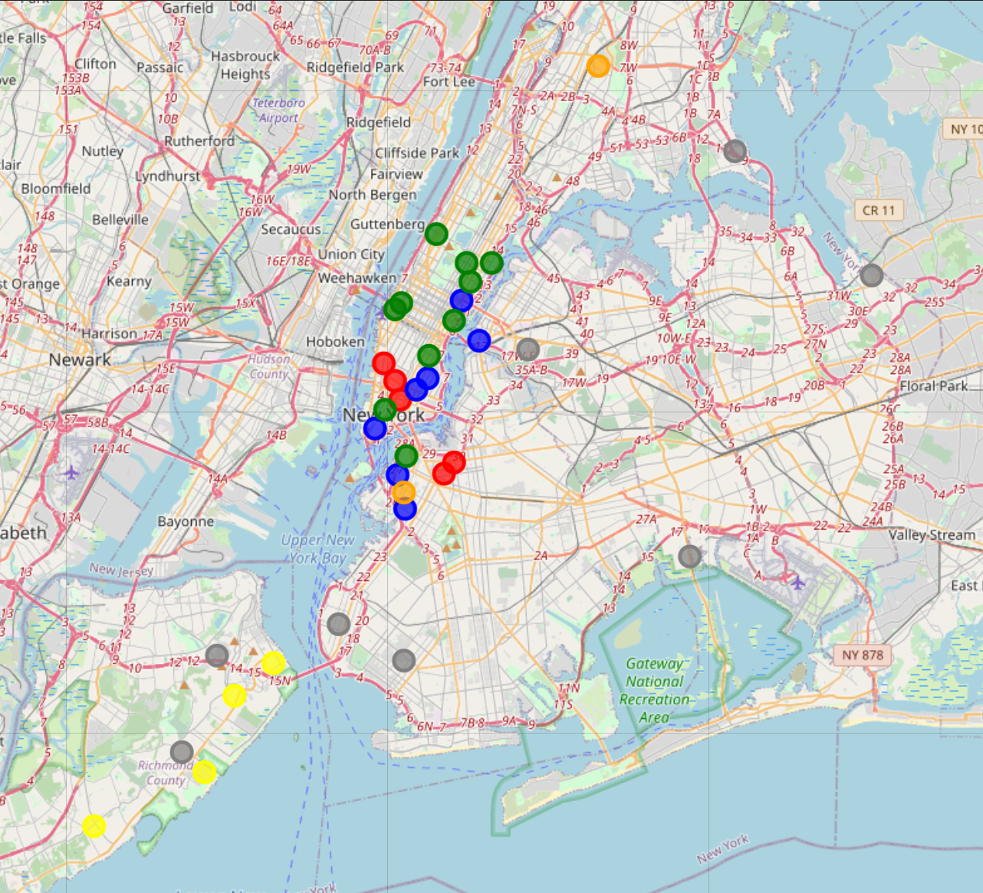
Clustering Italian restaurants in NYC| Analytical Model
K-Means Clustering
Legend
Cluster 0
Cluster 1
Cluster 2
Cluster 3
Cluster 4
Cluster 5
Each borough is composed by neighborhoods of different clusters.
Bronx and Staten Island: equally split in 2 clusters (respectively 4-5 and 3-4)
Brooklyn: Mix of 4 clusters (0-1-2-4-5)
Manhattan and Queens: mostly 1 cluster + minor clusters (respectively 2+0-1 and 4+1)

Slide 7
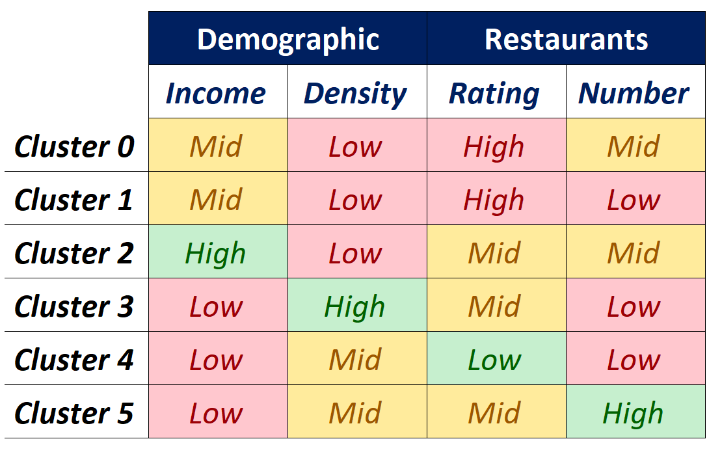
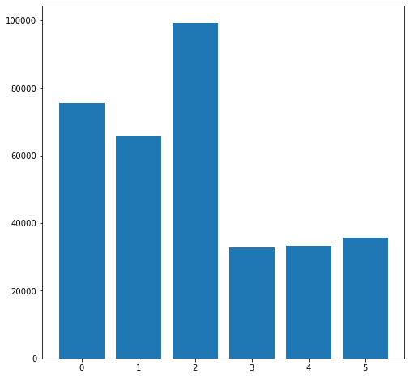
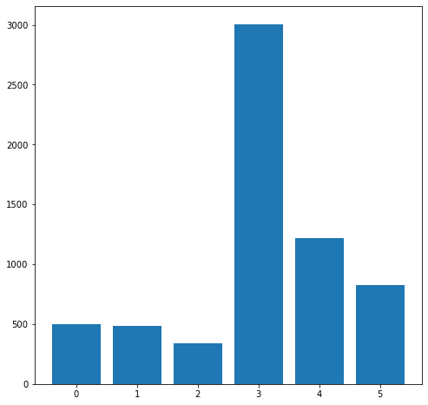
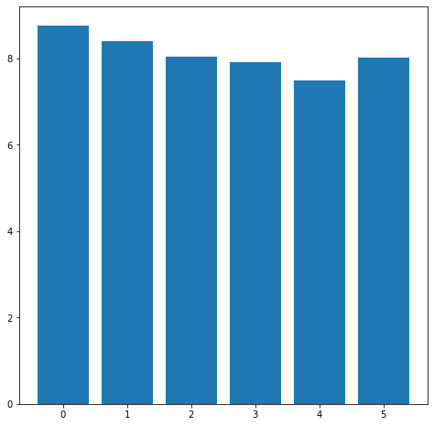
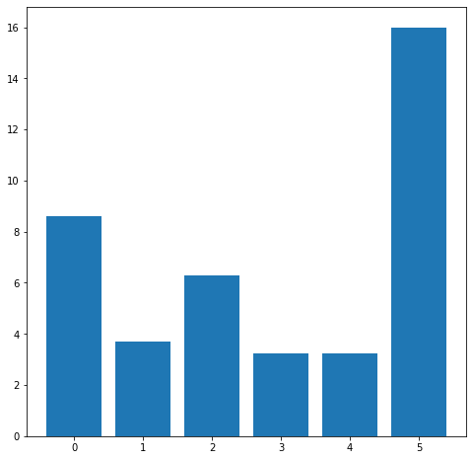
Clustering Italian restaurants in NYC| Discussion
Which is the best Neighborhood?
Income per Cap
Density
Demographic
Cluster 2
Cluster 5
Rating
N. Of Restaurants
Represent areas where to open an italian restaurant based on quality, raw material of first choice and high target of people. This because in those neighborhoods there is a low density of high-class population so the restaurant should be based on quality more than quantity. Moreover, the competition is middle level, this means that Italian Restaurants are quite appreciated but since the number of restaurants is mid, probably potential customers could prefer other cuisines. For this reason, I would suggest introducing some fusion cuisine elements in the menu in order to be more attractive in the market.
Represent areas where to open an Italian restaurant more based on a fast and friendly service and with a business model based on high quantities and low prices. This because in this area there is a Mid density of low-class population so the restaurant should attract a lot of people taking also into account their economic power. Moreover, the competition shows a high number of Italian restaurants with mid average rating. This means that Italian cuisine is very appreciated in these neighborhoods but there are already a lot of appreciated venues. For this reason, I would suggest applying marketing strategies for customer retention and brand awareness (for example membership cards, “bring a friend” promo, social media marketing campaigns and so on).
Restaurant

